Slide 1
SQL Server Machine Learning Services
In-Database Machine Learning in SQL Server

Slide 2
Agenda
Why ML In-Db
How does it work?
Security

Slide 3


Bringing Intelligence to where Data Lives
Application
Application + Intelligence
VS
Database
Intelligence + Database
Regular Database + App
Intelligence Database + App

Slide 4
Why In-database ML with SQL Server?
Better Collaboration and Insights Sharing
Streamlined Deployment of R/Python Scripts and Models
Faster Time to Insights
Better Security and Compliance

Slide 5

Better Collaboration and Insights Sharing
App Developer
Share & Consume
Explore and experiment with SQL Server data in your favorite IDE - use R, Python, T-SQL.
Make apps intelligent -Consume machine learning models from any app with a simple stored proc call
Explore
SQL Server
Machine Learning Services
Data Scientist
SQL Developer/DBA
Train
Train models remotely on SQL Server from your IDE
Train models using R/Python code embedded in T-SQL stored proc.
Deploy and schedule training and prediction scripts in-DB - make models and predictions accessible to any application
Manage model version in DB
Deploy
Data Scientist

Slide 6

Streamline Productivity and Simplify Deployment
Separate service or embedded logic
Applications
Predictions
Scoring
Applications
Model Operationalization
New
data
Transactions
Predictions
Transactions
Model Training
DB
Data
Transformations
MODEL
SQL Server
Analytics server
Data
Transformations
Data Movement
Model Training
MODEL
Scoring
Machine Learning outside of DB
In-DB Machine Learning

Slide 7
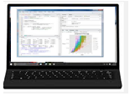

Data Scientists - Data Exploration and Model Development
1
Script
SQL Server
Data Scientist Workstation
3
Results
2
Execution
Any R or Python IDE

Slide 8
Value for Data Scientists
Work with full datasets (not samples) without moving data out of secure, compliant boundaries
Work from your favorite IDE; remotely leverage the power of SQL Server
Work with ANY open source package in-database
Leverage scalable, fast MS algorithms and pre-trained models when needed – combine the best of open source and MS options
Streamlined model deployment without developer dependence
Model version management in-database

Slide 9
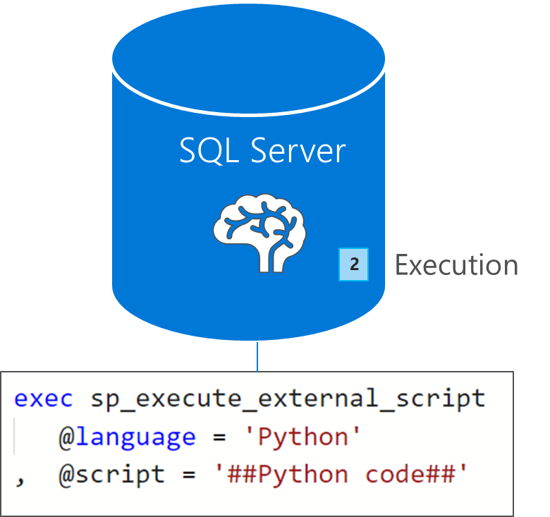
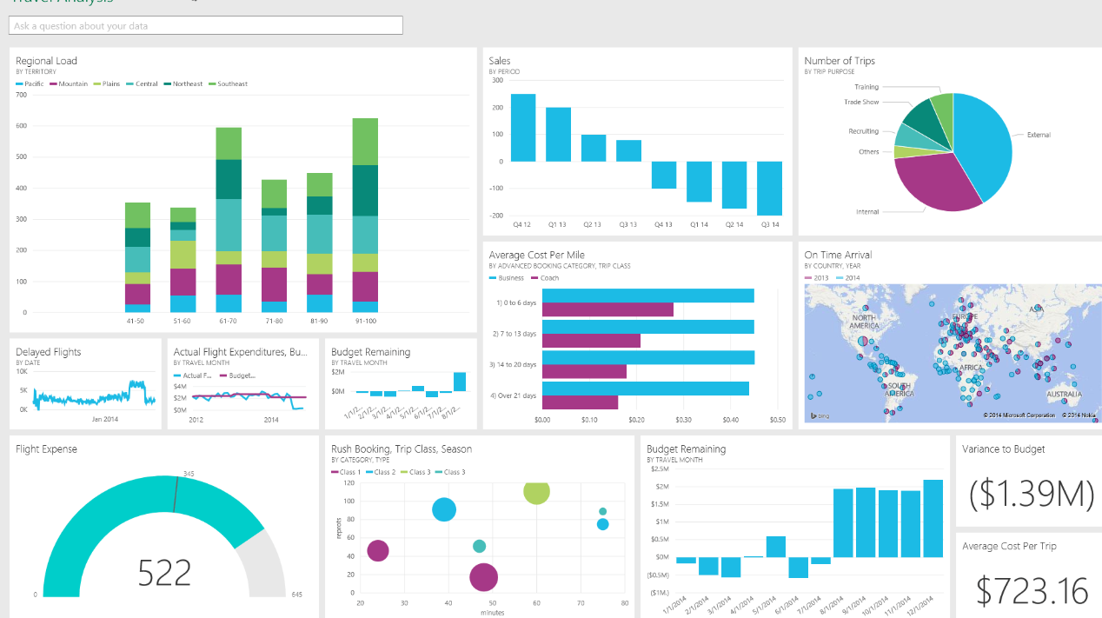
Data & App. Developer - Model Deployment & Consumption
1
Call store proc
3
Results
Application

Slide 10
Value for Data and Application Developers
App Developers – make existing and new apps intelligent
Consume models easily by simply calling a T-SQL stored procedure
No knowledge of models or model conversion into other languages needed
Data Engineers and DBAs – leverage the power of R/Python
General purpose data processing
Create powerful data visualizations.
DBAs – securely enable their organizations to do machine learning and AI on SQL Server
Manage, govern and secure the resources

Slide 11
Faster Time to Insights
Integration with SQL query execution
Parallel query pushing data to multiple external processes / threads
Use in-memory technology and Columnstore Indexes alongside your ML scripts
Streaming mode execution
Stream data in batches to the R/Python process to scale beyond available memory
Train and Predict using parallelism
Leverage RevoScaleR/revoscalepy and scale your R and Python scripts using multi-threading and parallel processing
Native scoring for faster real-time predictions (New in 2017)
Notes:
Most R/Python functions are single threaded and only accommodate datasets that fit into available memory. Use SQL Server’s parallel query capabilities , in-memory technology and Columnstore Indexes alongside your ML scripts to boost performance. You can also leverage RevoScale support for large datasets and parallel algorithms to run your training and predictions using parallelization, and streaming to scale beyond available memory. With the native TSQL Predict function (also known as native scoring, introduced in 2017), you can get orders of magnitude faster times to insight (real-time).

Slide 12
ML Services (In-Database) is Secure
Reduced surface area and isolation
‘external scripts enabled’ required
R/Python script execution outside of SQL Server process space
Script execution requires explicit permission
sp_execute_external_script requires EXECUTE ANY EXTERNAL SCRIPT for non-admins
SQL Server login/user required and db/table access
R/Python processes have limited privileges
R/Python processes run under local user accounts in the SQLRUserGroup
Each execution is isolated. Different users with different accounts
Windows firewall rules to block outbound traffic
'
'

Slide 13
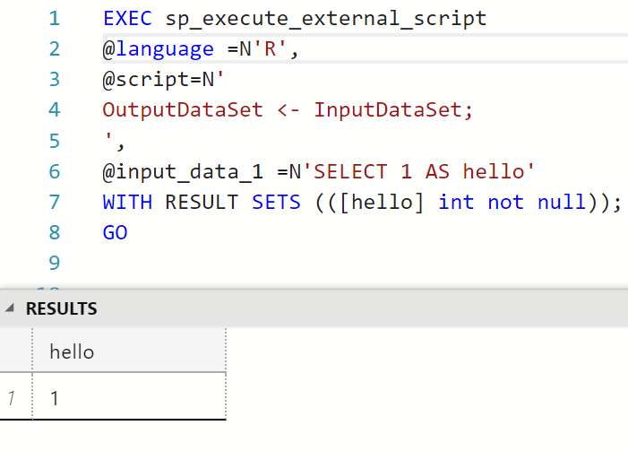
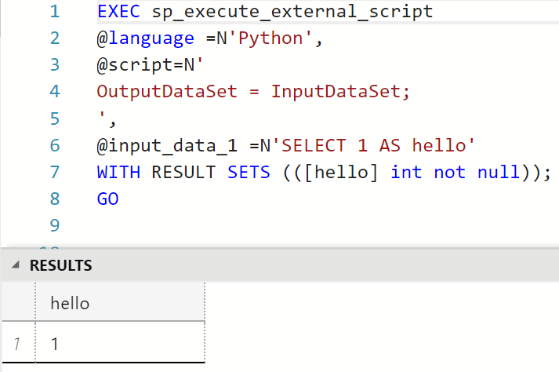
Run R and Python In-Db

Slide 14
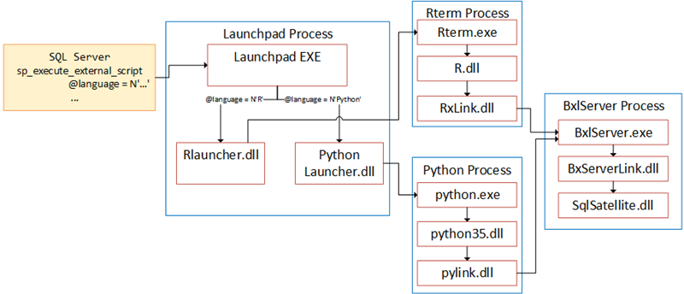
Architecture

Slide 15
Roadmap
Azure SQL Database
R support, followed by Python
ML Services in SQL Server on Linux
Additional algorithms and pre-trained models
Failover cluster support
Partitioning support for input data
Native Scoring for more models
Support for more languages ???

